Slide 1
SRM200A JIG
2019. 08. 05

Slide 2
SRM200A 공정 항목
순서 | 공정 | 항목 | 통신Port | Remark
1 | 기능검사 | 1. PIN check 2. F/W Down-oad - BLE F/W - WIFI F/W - Sigfox F/W | 각IC별 intrface
2 | RF성능 검사 | 1. 전류 check. 2. check Sigfox ID/PAC, WIFI MAC, BLE MAC, F/W version 3. RF Test(GPS, Acc, SFX, WIFI, BLE) 4. RF pass시 Write SFX ID/PAC/KEY(MES연동) 5. RF fail시에는 write 없이 fail처리 6. Log(RF Test result, S/N, SFX ID/PAC, WIFI/BLE) | BLE I2C

Slide 3
SRM200A 공정 순서
<기능검사>
<RF성능검사>
START
START
Read QR Code
- Lot Number
- Serial Number
Read QR Code
- Lot Number
- Serial Number
RF Test
1. GPS
2. Accelerometer
3. Sigfox
4. WIFI
5. BLE
PIN Test
Initial Current Check
Auto Selection F/W
- BLE F/W Download
- WIFI F/W Download
- Sigfox F/W Download
check Sigfox ID/PAC
Read WIFI MAC
Read BLE MAC
F/W version check
Write Sigfox ID/PAC/KEY
Log
- RF Test result
- S/N, SFX ID/PAC, WIFI/BLE
END
END

Slide 4
SRM200A JIG설계
- SRM200A Dimension

Slide 5
SRM200A JIG설계
- SFM20Rx vs SRM200A pin-map
<SFM20Rx pin-map>
<SRM200A pin-map>

Slide 6
SRM200A JIG설계
- SFM20Rx vs SRM200A Boot Mode set
<SFM20Rx Mode set>
<SRM200A Mode set >

Slide 7
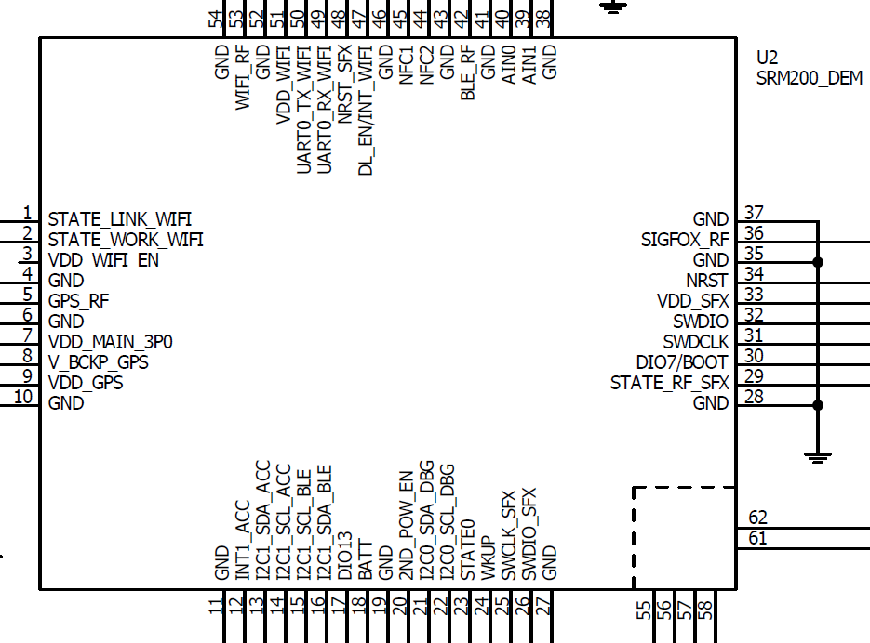
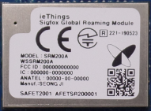
- D/L JIG
1. Test F/W down-load
2. BLE, WIFI, SFX F/W
3. 외부연결
- BLE: J-link 사용
SWDIO, SWDCLK
- WIFI: UART to USB JIG 사용
UART0_RX_WIFI, UART0_TX_WIFI
- SFX: ST link사용
SWCLK_SFX, SWDIO_SFX
WIFI
+3.3Vdc
BLE
SFX
Socket B’d
< Module connect port >
* Boot mode set 재설정.
** BLE, WIFI D/L연결은 SFM20Rx와 동일.
SFX PIN은 재설정.
J-link
UART
To
USB
ST link
+3.3Vdc
PC
PS

Slide 8
- RF Test JIG
1. RF Test
2. BLE, WIFI, GPS, SFX, Acc Test
3. 외부연결
- BLE: UART to USB 사용
AIN0, AIN1
- WIFI: UART to USB 사용
UART0_RX_WIFI, UART0_TX_WIFI
- SFX, Acc: I2C to USB 사용
I2C0_SDA_DBG, I2C0_SCL_DBG
- GPS: USB 사용
USB_DP_GPS, USB_DM_GPS
WIFI
BLE
+3.3Vdc
SFX
GPS
Socket B’d
< Module connect port >
I2C
to USB
* Boot mode set 재설정.
** BLE, WIFI, SFX, Acc, GPS Test 연결은
SFM20Rx와 동일.
UART to USB
UART to USB
USB
USB
+3.3Vdc
PC
PS

Slide 9
- RF Test Item
1. BLE, WIFI, GPS, Acc RF Test Item은 동일
2. Sigfox RF Test Item
1) TX power (RC1/RC2/RC3c/RC4/RC5/RC6)
2) Freq. err (RC1/RC2/RC3c/RC4/RC5/RC6)
3) Beacon 수신감도 (RC1/RC2/RC3c/RC4/RC5/RC6)
4) Data 수신감도 (RC1/RC2/RC3c/RC4/RC5/RC6)
* 각 region별 모두 Test할 수 있게 구현 및 skip가능하게 구현.

